Slide 1
Capstone Project - 3
Seoul Bike Sharing Demand Prediction
Team Members
Ritesh Rajurkar Bapu Bordekar

Slide 2

Content
Problem Statement
Introduction
Exploratory Data Analysis
Data Summary
Hypothesis
Model Building
Evaluation
Challenges
Conclusion
Q&A

Slide 3

Problem Statement
Predict the demand of bike rent based on the historical usage over different factors such as seasons, weather, temperature, humidity etc. where there is hourly rental data for one year 2017-2018.

Slide 4
Introduction
Prediction of bike sharing demand can help bike sharing companies to allocate bikes better and ensure a more sufficient circulation of bikes for customers.
This presentation proposes a real-time method for predicting bike renting based on historical data, weather data, and time data.
This demand prediction model can provide a significant theoretical basis for management strategies and vehicle scheduling in public bike rental system.
We evaluate the model inter alia with the Root Mean Squared Error and show that the prediction of proposed model outperforms that of other regression models by comparing their RMSE.

Slide 5
Data Summary
Date : year-month-day
Rented Bike count - Count of bikes rented at each hour
Hour - Hour of the day
Temperature- in Celsius
Humidity - %
Wind Speed - m/s
Visibility - 10m
Dew point temperature - Celsius
Solar radiation - MJ/m2
Rainfall - mm
Snowfall - cm
Seasons - Winter, Spring, Summer, Autumn
Holiday - Holiday/No holiday
Functional Day - NoFunc(Non Functional Hours), Fun(Functional hours)

Slide 6
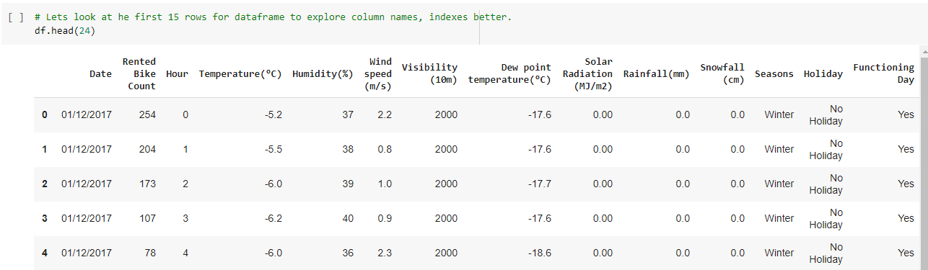
Let’s Look At our Dataset
The original dataset has 14 columns and 8760 rows.
The data types of various columns are Object,Float and Integer.
Dependent variable being Rented Bike Count and all other variable are our feature or independent variables like Hour,Temperature etc.

Slide 7
Hypothesis
The dataset shows hourly rental data for one year (1 December 2017 to 31 November(2018)(365 days).We are required to predict the total count of bikes rented during each hour.
There is high demand during peak hours. This high demand might be due to office hours(i.e. 8am to 6pm) and there is low demand during 10:00 pm to 4:00 am.
In general, temperature has negative correlation with bike demand.
There is high demand for rented bikes on non holiday and low demand on holidays.
There is zero demand on Non Functioning Day.

Slide 8
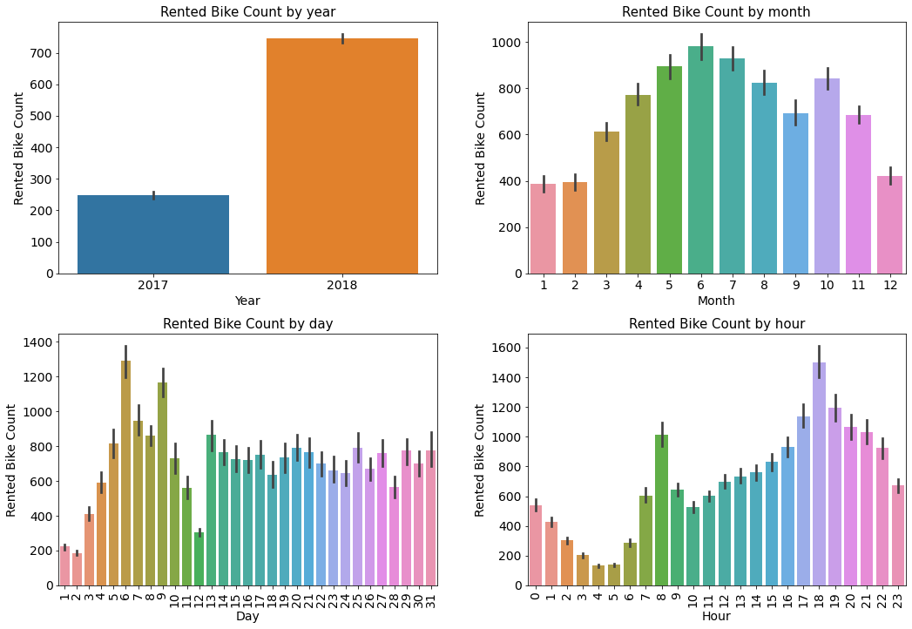
Date Wise Trend

Slide 9
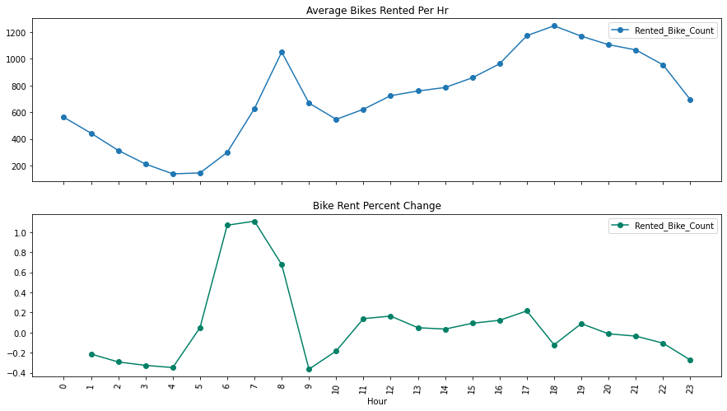
Exploratory Data Analysis: “Hour” Column
Demand for rented bikes is less during night hours between 12 am to 4 am.
Demand drastically increased on 8 a.m. It seems this increased due to office hours.(We can’t reject Hypothesis)

Slide 10
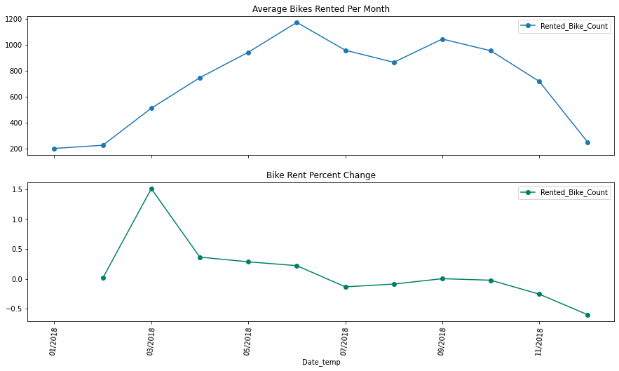
Analysis Of Rented Bike Count By Month
We can see increasing trend from 1st month to 6th month of 2018. The demand for rented bikes is highest during 6th month of 2018.
The declining trend continues after 6th month as evident from following graph.

Slide 11
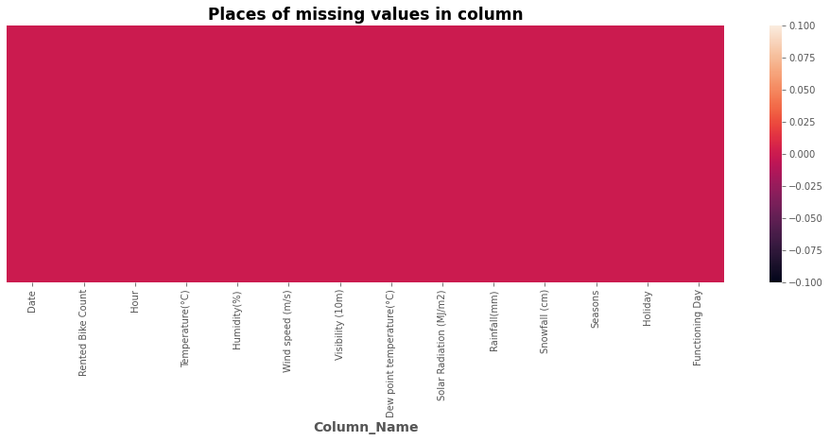
No Missing Values in Dataset

Slide 12
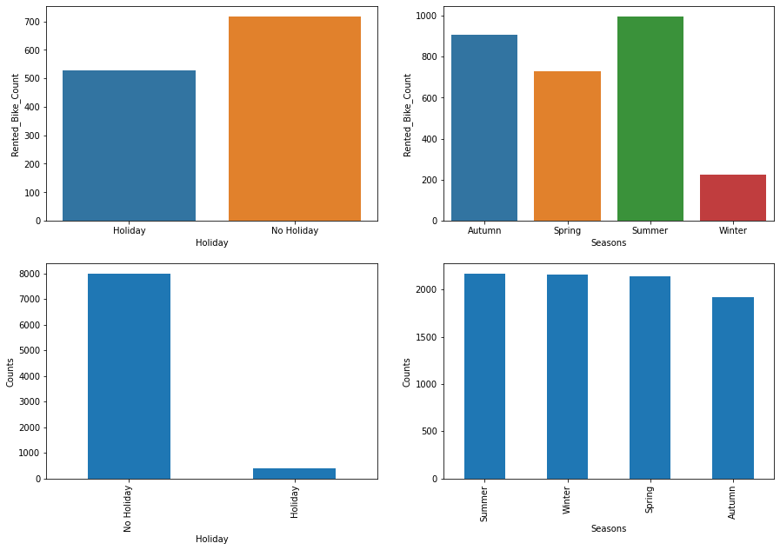
Exploratory Data Analysis

Slide 13
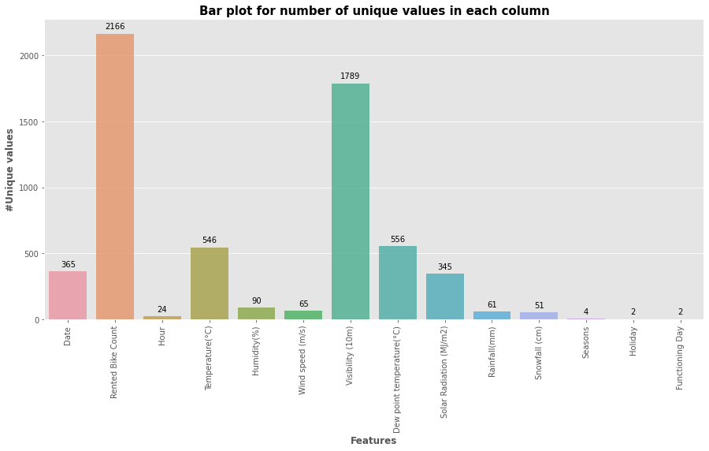
Unique Values in Our Dataset

Slide 14
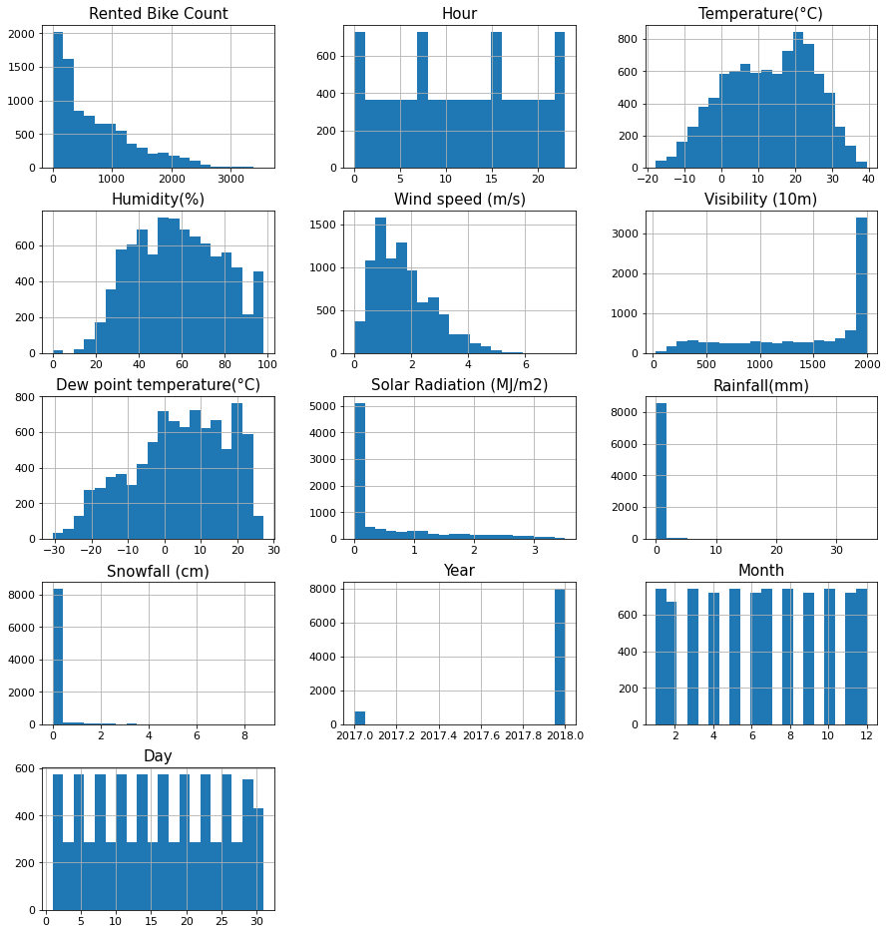
Distribution Of Features
“Temperature” and “Humidity” columns follows uniform distribution.
“Wind Speed”, “Solar Radiation”, “Rainfall” and “Snowfall” are having positively skewed distribution.
“Dew Point Temperature” and “Visibility” are negatively skewed.

Slide 15
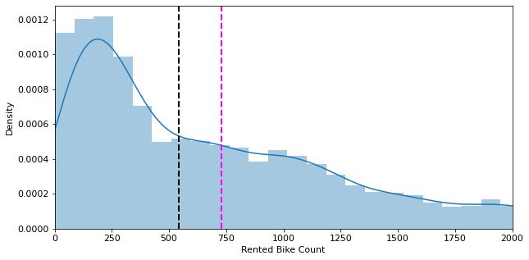
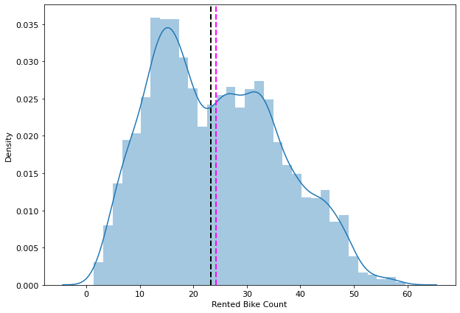

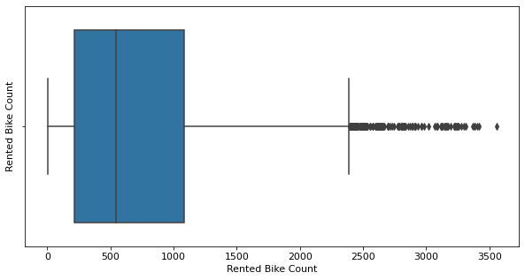
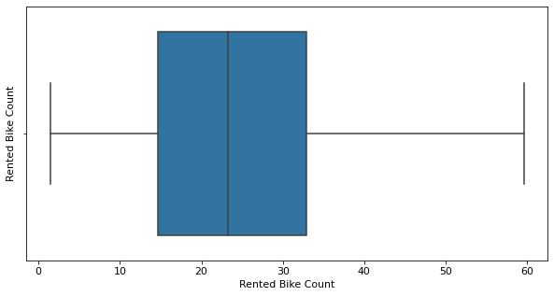
Distribution Of Dependent Variable

Slide 16
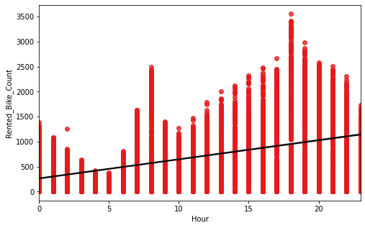
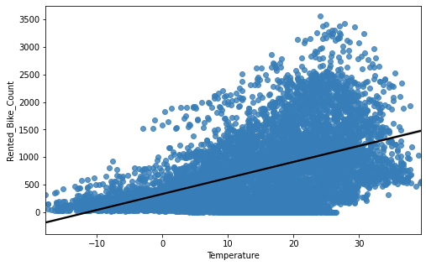
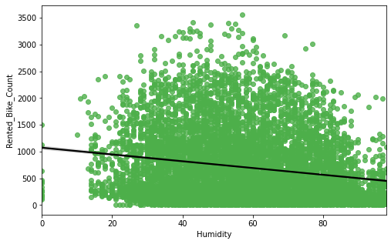
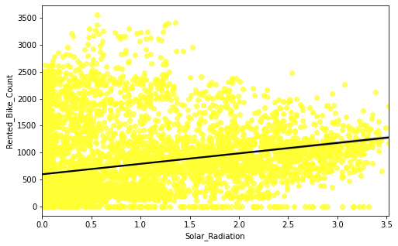
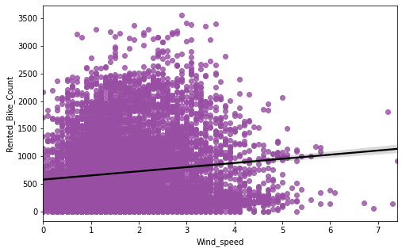
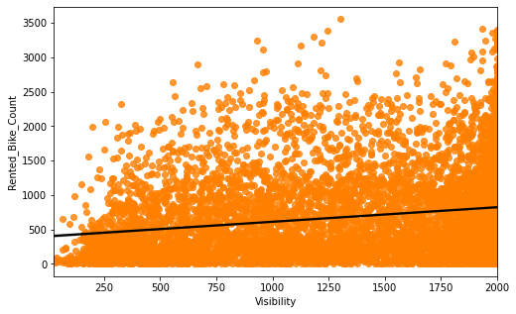
Data Preprocessing: Assumptions Check

Slide 17
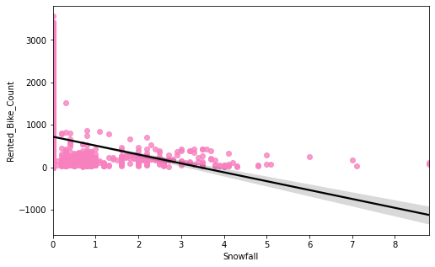
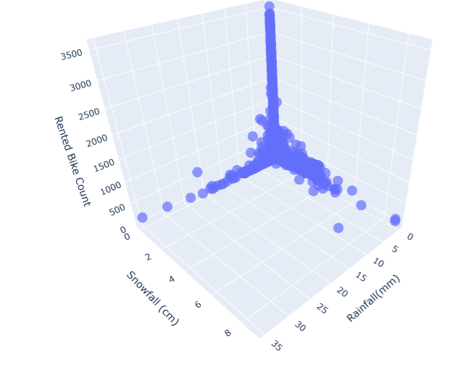
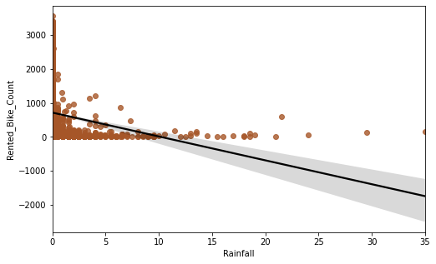
….Assumptions Check

Slide 18
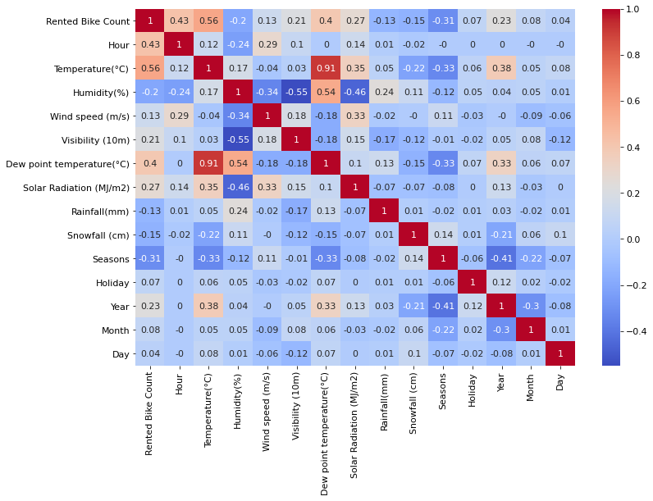
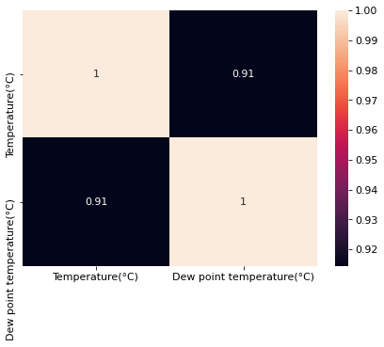
Multicollinearity
Variables like Dew Point Temperature, and Temperature are highly correlated.

Slide 19
Data Pre-processing
Implemented PCA “Dew Point Temp” and “Temperature” as they were highly correlated.
Also removed observations where it was “Nonfunctional Day” and bike rent was zero and removed the column as well.
We have also dropped “Date” column as it would not help in giving good prediction for model.

Slide 20
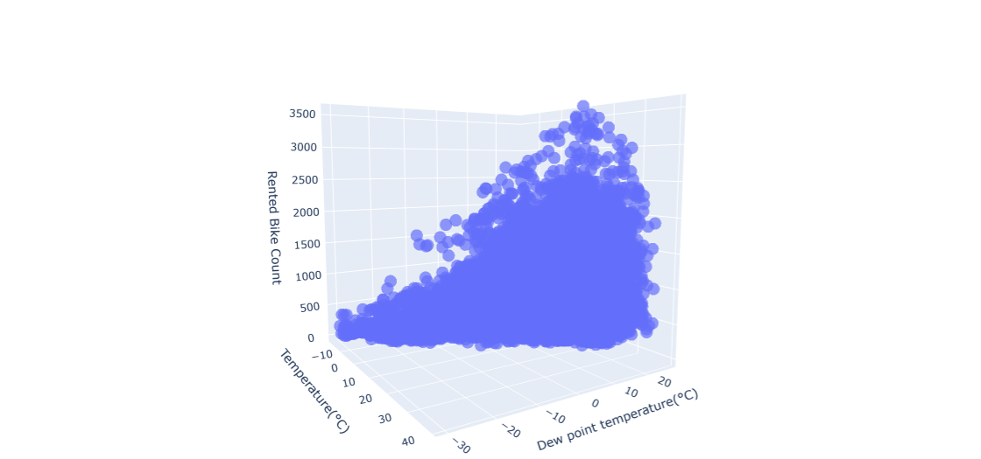
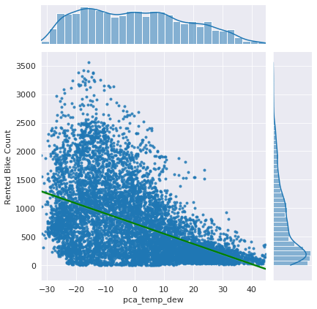
PCA For Temperature and dew point temp

Slide 21


Model Building
Linear Regression - Lasso, Ridge
Decision Trees
Random Forest
Gradient Boosted DT
Cat Boost
XGBoost

Slide 22
ML Models and Metrics
TYPES | R2- Score | Adj R2 | MSE | MAE
Linear | 0.507305 | 0.504966 | 198793.5 | 333.689
Linear/Lasso | 0.524954 | 0.514745 | 198793.6 | 333.689
Linear/Ridge | 0.507065 | 0.505745 | 198890.4 | 333.764
Decision Tree | 0.735990 | 0.734736 | 198890.4 | 192.533
Gradient Boosting | 0.831606 | 0.830806 | 67943.8 | 192.514
Random Forest | 0.850903 | 0.850195 | 60157.9 | 150.875
XGBoost | 0.944733 | 0.944535 | 54287.03 | 143.48
Cat Boost | 0.810632 | 0.865745 | 76847.60 | 192.48

Slide 23
Best Parameters using Bayesian optimisation for the Xgboost
'base_score': 0.5, 'max_depth': 9,
'min_child_weight': 20, 'n_estimators': 100, 'objective': 'reg:linear', 'reg_alpha': 0,
'random_state': 0, 'scale_pos_weight': 1,
'reg_lambda': 1, 'subsample': 1,
'booster': 'gbtree', 'colsample_bylevel': 1, 'colsample_bynode': 1, 'colsample_bytree': 0.7,
'eta': 0.004, 'gamma': 0, 'importance_type':'gain', 'learning_rate': 0.1, 'max_delta_step': 0,

Slide 24
Bayesian optimisation parameters Table
| iter | target | colsam... | gamma | max_depth |
-------------------------------------------------------------
| 1 | -4.18 | 0.7168 | 0.5418 | 3.979 |
| 2 | -3.788 | 0.7322 | 0.6974 | 5.94 |
| 3 | -4.374 | 0.351 | 0.253 | 3.475 |
| 4 | -3.683 | 0.9 | 1.0 | 7.0 |
| 5 | -3.705 | 0.8951 | 0.07094 | 6.993 |
| 6 | -3.894 | 0.3 | 1.0 | 7.0 |
| 7 | -3.702 | 0.8995 | 0.6334 | 6.777 |
| 8 | -3.698 | 0.9 | 0.0 | 6.16 |
=============================================================

Slide 25
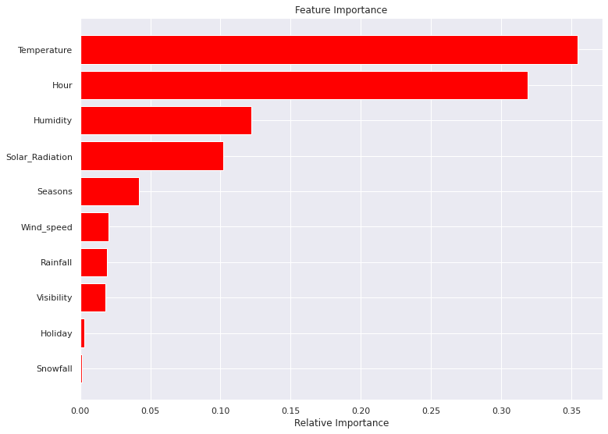
Feature Importance

Slide 26
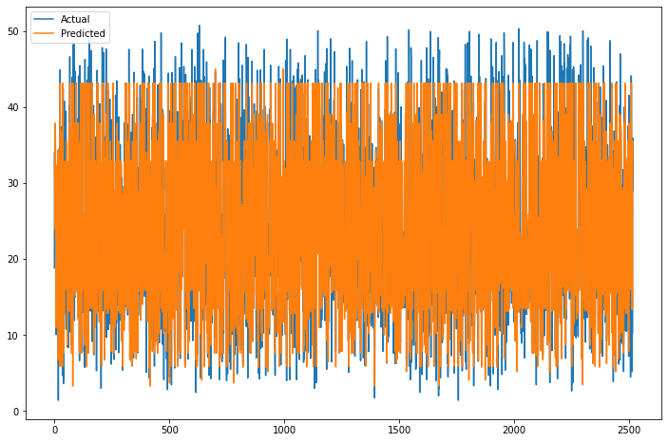
Actual Vs Predicted

Slide 27
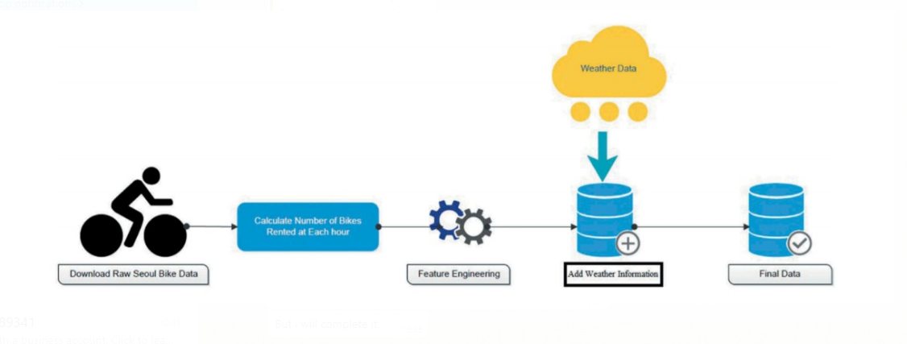
Challenges
Feature engineering
Feature selection
Model Training and performance improvement

Slide 28
Conclusion
When we compare the root mean squared error and mean absolute error of all the models, the XGBoost model has less root mean squared error and mean absolute error, ending with the R-squared of 94% . So, finally this model is best for predicting the bike rental count on daily basis.
As we can see the total amount of bike rentals increases with the temperature per month. Whereas it seems that the rentals are independent of the wind speed and the humidity, because they are almost constant over the months. This also confirms on the one hand the high correlation between rentals and temperature and on the other hand that nice weather could be a good predictor. So people mainly rent bikes on nice days and nice temperature. This could be important of planning new bike rental stations.

Slide 29
Q & A

